Slide 1


Welcome to
Reception Class
2026-2027

Slide 2
Welcome to
Blakedown CE Primary School
We are so pleased your child will be starting our Reception Class and are looking forward to helping them settle quickly. Being in Reception is the most wonderful adventure where your child will play and learn new skills every day. By the end of the year, they will be able to do so many amazing things. They will have explored the world around them and most importantly had so much fun!

Slide 3

Our school Vision and Values
At Blakedown, the roots of our vision are from Psalm 139:14
'I will praise you because I am fearfully and wonderfully made'
derived from the fact that we are all unique and made in God's image with individual talents and dreams.
At Blakedown we want our children:
to be happy in and out of school, to have a deep-rooted sense of JOY in their lives and to be content and comfortable with who they are;
to recognise their individuality and to use their talents and abilities in SERVICE of others;
to be equipped with a love of learning and the skills and resilience to flourish in the face of life's challenges to ACHIEVE and be the best version of themselves.

Slide 4
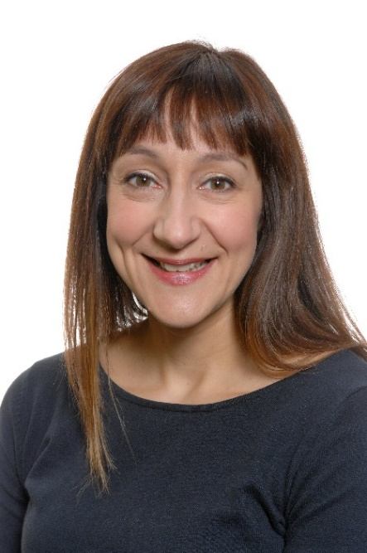
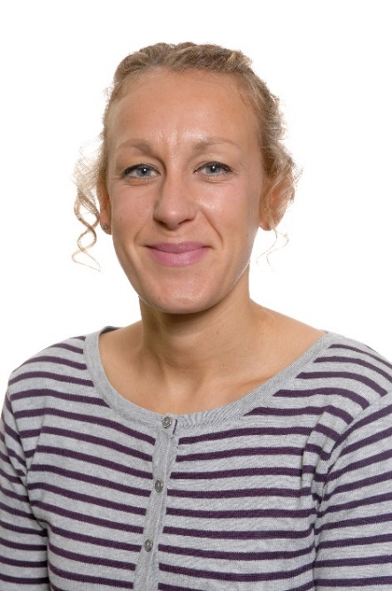
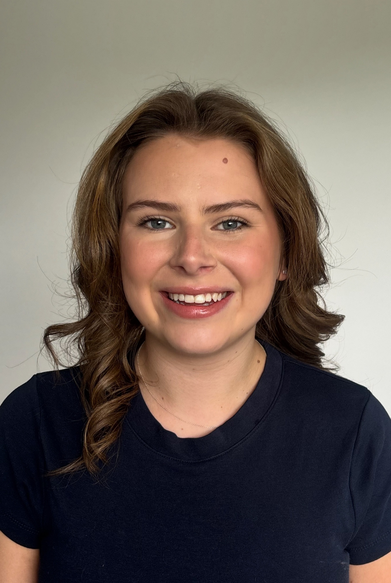
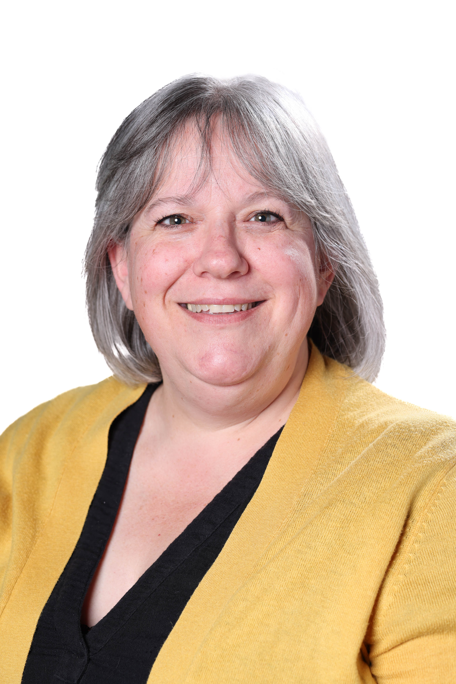
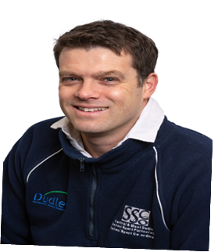
Who’s Who?

Slide 5
How will we get to know you?
Home Visits
For children starting Reception in September, we will arrange a time when Mrs Nash and Miss Welsh or Mrs Beckford-Bond can visit you and your child at home. Your child can share their favourite toys and tell us about what they like to do.
When we come to visit you, we will ask you and your child some questions that will help us find out lots of information about your family.
Visiting Your New Classroom
Before your child starts school in September, they will be invited to meet us and to see their new classroom on ‘Transition Day’. We will let you know the date for this very soon. There will be lots of toys out that they can play with and lots of new friends that you will get to meet.
Notes:
5

Slide 6
Starting School
Day 1 and day 2 the children will be in 2 small groups
Day 3 they will come as 1 group and stay for lunch-please provide a packed lunch
Transition Dates
Tuesday 14th July am or pm
Thursday 3rd September am or pm
Friday 4th September to include lunch

Slide 7
Our Day in Reception
8.40am | Main gates and entrances to school open
8.40am | School starts and an adult will meet you at the entrance door
8.50am | Morning Register
11.50am | Lunch Time
1.00pm | Afternoon Register
3.20pm | End of school day
3.20-5.30pm | Wraparound after school provision is open. This must be pre-booked and paid for.

Slide 8
Snack Time
Free milk (until age 5) and fruit is available and we encourage all children to access this at snack time. If your child is not able to have milk for whatever reason, please let us know and we will speak with you about alternative arrangements. We also encourage children to bring in a water bottle from home to keep in school to access throughout the day, water only. Please make sure the water bottle has your child’s name on.
Lunchtime
Packed Lunch - Children may bring a packed lunch and drink which should be in a named container/lunch box. This will be stored in the Reception Class cloakroom during the day. Please do not send in fizzy drinks, anything with nuts or unhealthy snacks or sweets.
School Lunches - School dinners are FREE for all children in Reception, Year 1 and Year 2.

Slide 9
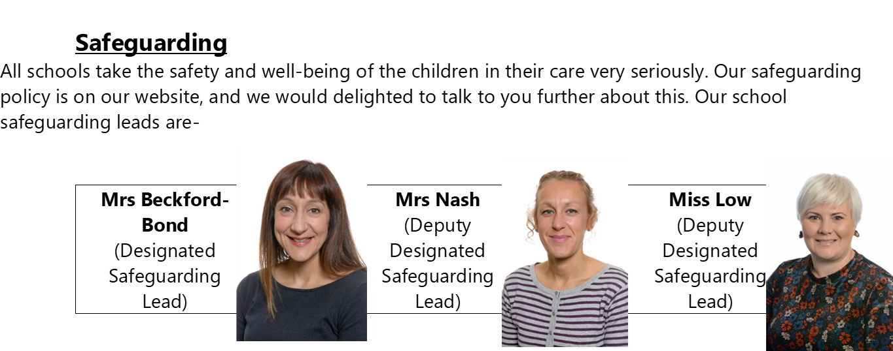
Key Information

Slide 10
School Uniform
We are keen for the children to wear full school uniform (which must be clearly named) as uniforms provides smart, practical clothing which is not too expensive.
Our uniform consists of:
Grey (trousers)
Blue pinafore or skirt
Light Blue shirt
Blue cardigan or sweatshirt
Sensible, black shoes (Velcro fastenings please!)
Blue and white checked summer dress
Wellington Boots
NAME EVERYTHING.

Slide 11
Absences and illness
At Blakedown CE Primary attendance is a key area of priority. Absence, particularly in early education, has a considerable effect on children’s development. If your child is away from Reception because of any illness, please notify us as to the reason for the first day of absence. We strongly discourage parents from booking holidays in term time. These can now be fined.
If your child suffers from a medical condition requiring treatment such as an inhaler, we will require up to date medication to be kept in school. A form will need to be completed at the office.
It is important that we can always contact parents in cases of emergency. We will require two emergency contact details. Please inform school immediately if your telephone number changes.

Slide 12
The Early Years Curriculum
In September 2021, a new Early Years Statutory Framework and curriculum guidance was introduced. For us at Blakedown this felt like a big opportunity modify our practice and continue to develop all the things that we believe are so brilliant about Early Years at Blakedown.
Our EYFS curriculum is split into 7 areas of learning, 3 prime areas and 4 specific areas:
Personal, Social and Emotional Development
Physical Development
Communication and Language
Literacy
Mathematics
Understanding the World
Expressive Arts and Design

Slide 13
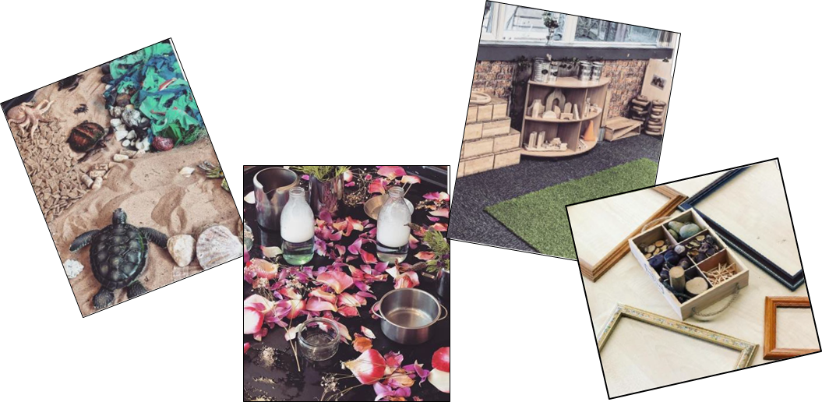
Our EYFS curriculum also includes the Characteristics of Effective Learning. These focus not on what children know but how children learn.
Playing and Exploring – our children investigate and experience things and events around them and ‘have a go.’
Active Learning – our children concentrate and keep trying if they experience difficulties, as well as enjoying what they achieve.
Creating and Thinking Critically – our children have and develop their own ideas, make links between different and experiences and develop strategies for doing things.

Slide 14
Forest School
Forest School is an inspirational process, that offers children and young people opportunities to achieve, develop confidence and self esteem, through hands on learning experiences in a local woodland environment.
Through this child initiated approach we aim to fulfil children’s:
Self awareness
Self regulation
Intrinsic motivation
Empathy
Social and communication skills
Independence
Positive attitude

Slide 15
Trips and Visitors
We will go on a trip at least once every half term, we like to use our local area as much as we can. We also like to invite visitors to school, so if you have anything interesting to share, please let us know.
Recent trips and visitors have included:
              Ladies Pool
              Theatre trip
              Hagley Library
              Church
              Churchfield’s Farm
              HSBC
              Platform Rail
              Balanceability

Slide 16

Phonics and Early Reading
At Blakedown Primary School we use Little Wandle Letters and Sounds as our chosen Department for Education-validated phonics programme.
Little Wandle Letters and Sounds Revised provides all the planning, resources and support needed. Our pedagogy ensures optimum learning for the maximum number of children. Taught with fidelity, in parallel to the committed development of vocabulary and comprehension, and in a context that embraces reading for pleasure, it can provide reading success for all children, regardless of their background.

Slide 17
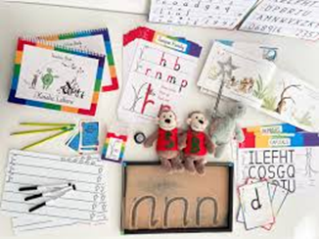
Writing
At Blakedown Primary School we use Kinetic Letters as our chosen handwriting programme.
  Narrows achievement gaps between pupils
  Benefits self-esteem and engagement with learning
  Strengthens muscles for comfortable, pain free writing
  Improves spelling, reading and editing
  Increased writing stamina
  Handwriting becomes a fundamental life-skill

Slide 18

Maths
At Blakedown Primary School, we use White Rose Maths as our chosen maths scheme.
This engaging and inspiring early years maths resources help children explore mathematics in meaningful ways. They also encourage the development of the core maths skills that make up the early years curriculum.

Slide 19

Evidence Me
In Reception we will share your child’s learning with you via their online learning journal. We do this via an app called ‘Evidence Me’. This is free for parents to download and access and you will be able to see photographs of your child’s learning within school. We also encourage families to upload photos and videos of what their children get up to at home. Your child will be a focus or ‘Target Tiger’ at least once a term.
This is a brilliant way of supporting your child with their speaking and listening skills, boosts the children’s confidence and is a great way of helping staff learn more about your child on a personal level.

Slide 20

Stay and Play
At least every term we invite families into school to work alongside their child and learn how they can support them at home. Sessions can include-
Kinetic Letters
Phonics
Multi-skills

Slide 21

It is good to talk…
For some of you your child’s first day of school cannot come soon enough! For others the thought of your child starting Reception may make you feel worried and anxious. However you may be feeling, one thing that we ask of you is that you talk to your child about starting school in a positive way. Let them talk to you about any worries that they may have or what they are looking forward to. Show them that you are excited about the new adventure that they are about to start and use this booklet to talk about what the school day will look like for them.
We are not only here for the children, but for our parents and community too. If you ever need help, advice or support please do come and chat to us and if there is anything at all we can do to help, we will.
If there is anything else you need to know, please do not hesitate to come and speak to us. We really are looking forward to working with you to make sure that your child has the best possible start to their time at school!
The three-week wobble!

Slide 22

We cannot wait to welcome your child to Reception!
😊
Contact us-
earlyyears@blakedownprimary.worcs.sch.uk

