Slide 1



MULTIPLICATION
CHECK
Monday 1st June and Friday 12th June

Slide 2
WHAT WE
ARE AIMING FOR
  To understand what the statutory multiplication check (MTC) is
  To find out when the check takes place
  To understand what we are doing in school to prepare for the check
  To share ways in which you can support at home
  To highlight the importance of encouraging your children to practise their times tables frequently (with a focus on the 6, 7, 8, 9 and 12 times tables)
Aims

Slide 3
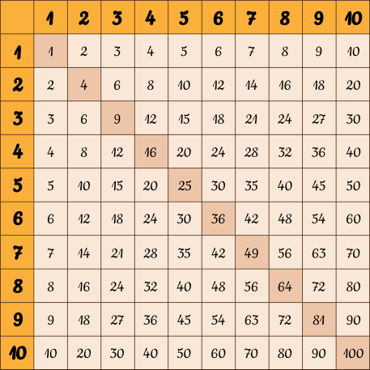
INTRODUCTION
What does MTC mean
The multiplication tables check (MTC) is statutory for all year 4 pupils registered at state-funded maintained schools, special schools or academies, including free schools, in England.
The purpose of the MTC is to determine whether pupils can recall their times tables fluently, which is essential for future success in mathematics.

Slide 4


WHEN WILL THIS TAKE PLACE
In 2025, schools must administer the MTC to all eligible year 4 pupils between Monday 1st June and Friday 12th June.
Schools can use the following week, Monday 15th June to Friday 19th June, to administer the check to any pupils who were absent during the first 2 weeks

Slide 5
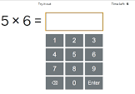
WHAT DOES IT
CONSIST OF
It is an on-screen check consisting of 25 times table questions. Your child will be able to answer 3 practice questions before taking the actual check. They will then have 6 seconds to answer each question. On average, the check should take no longer than 5 minutes to complete.

Slide 6
WHAT IF MY CHILD
CANNOT ACCESS THE CHECK?
If you have any concerns about your child accessing the check, you should discuss this with your child’s teacher or headteacher
There are several access arrangements available for the check, which can be used to support pupils with specific needs. Your child’s teacher will ensure that the access arrangements are appropriate for your child before they take the check in June. The check has been designed so that it is inclusive and accessible to as many children as possible.

Slide 7
The MTC has a time limit for each question, which can be a challenge for some learners with dyslexia who may struggle with speed or processing information quickly.
WHAT IF MY CHILD
CANNOT ACCESS THE CHECK?
The MTC administration guidance and the assessment framework outline access arrangements that can be used to support learners with dyslexia, including those who may struggle with the time constraints or visual presentation of the questions. These arrangements are designed to ensure that all learners can participate in the assessment and demonstrate their knowledge in a way that is fair and appropriate for their needs.
The visual presentation of the questions can be a challenge for some learners with dyslexia who may have difficulty with visual processing or organization.

Slide 8
DO I NEED TO DO ANYTHING?
No, you do not need to do anything additional to prepare your child for the check. As part of usual practice, teachers may ask you to practise times tables with your child.
We have access to a ‘try it out’ area, where each we ensure each child have the necessary support required to access the check. This includes opportunities for pupils to familiarise themselves with the check and try out any access arrangements that may be required.

Slide 9
WHAT IS THE PASS
Time for you to have a go!
  Check your knowledge https://www.timestables.co.uk/multiplication-tables-check/
  Play some times tables games with each other
MARK FOR THE TEST
At present the DfE have not issued an official "pass mark“.
As a school, we are aiming for a pass mark between 21 -25.

Slide 10



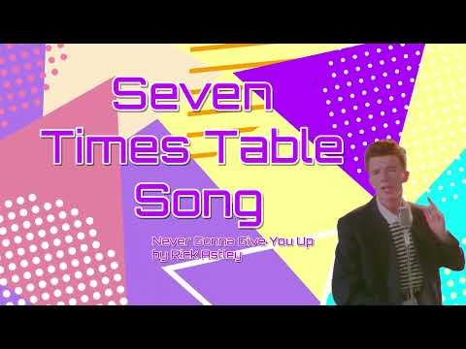
Ways to make times tables practise fun at home
  TTRS - https://ttrockstars.com/
  Hit the button - https://www.topmarks.co.uk/maths-games/hit-the-button
  Multiplication bingo, fastest finger, quizzes against family members, around the world, times table songs

