Slide 1




LKS2
EXPECTATIONS
2024/2025
Class Briefing for Parents and Students
Miss L Alton & Mrs L Anderson (Y3) and Miss H Jones (Y4)
JOY SERVE ACHIEVE

Slide 2
Weekly/Daily Routines
Every morning the children will have a morning activity. These are planned throughout the week to help settle the children, help cover curriculum objectives and to help get them become focused and ready for the day ahead, these include: handwriting, maths challenges, creative writing opportunities, reading tasks and well-being activities.
Children are expected to have their: reading records and homework due in on time on a weekly basis and it is essential that the children take the responsibility to get these organised and ensure they are in school on a daily basis.
On PE days, it is essential that your child arrives to school in their PE Kits (Tuesday & Wednesdays Y3 and Tuesdays & Thursdays Y4)
Please note that your child should come to school with: no jewellery apart from a pair of studded earrings; no painted nails; no loose hair below their shoulders without a hair tie and no access to smart watches linked directly to a mobile phone.
Please ensure your child has access to a suitable water bottle for the day and has a break time snack in the form of fruit or vegetables.
Each child should have a coat in school and have access to the appropriate footwear for social times such as a spare pair of shoes/trainers.

Slide 3
Homework
Homework is given out on a Friday and is expected back on a Wednesday morning.
Children have to complete at least one Maths and one Literacy activity a week –
children can complete any additional activities if they like by using our educational sites:
www.mymaths.co.uk
https://www.maths.co.uk/
www.spag.com
https://ttrockstars.com/
There will be an in-depth project focussed homework sent out each half term, which can be emailed to teachers via office@blakedownprimary.worcs.sch.uk or in the case of models, brought in on the designated day, towards the end of the half term.
Homework should be completed to the best of the child's ability and they should be proud of what they hand in, when it is due – please record this in pencil and ensure they try as much as they can independently. Any issues can be recorded by parents within the book itself so we can support where most appropriate.
  ~ There is a homework club available for the children to utilise on a Monday lunchtime in Year 4 ~

Slide 4

Curriculum: Our way of planning and learning to suit all
For information on the coverage of your child’s learning please visit the website below and find your child’s class page.
http://www.blakedowncofeprimary.co.uk/
On here you will find: routines, our class timetable, our curriculum overviews and any supporting resources for your child’s learning.
We encourage the children and yourselves to use this to ensure you are up to date with current events.

Slide 5
Curriculum: Key Stage 2
The demands of the curriculum continue to depend on children mastering their objectives by the end of their year groups. Standards are high and since changes to the curriculum in 2014, they continue to become more challenging each year. Children will either be: working towards, working at or working at greater depth within their curriculum objectives and this will be reported at parents evenings and within their summer report.
Each year has objectives that have to be taught, learned and understood by the children so that they can achieve the ‘expected standard’. They are progressive, therefore it is important that each year the children build on previous year’s knowledge. Our curriculum is designed in such a way to help the children develop these skills smoothly.
Our learning is planned to be interconnected where possible, whilst also ensuring children learn the required knowledge and skills for each subject area.

Slide 6
End of Term Assessments
Class teachers will be assessing your child in many different ways: one of the ways we assess the children is through end of term assessments or end of topic assessments. These help to support our teacher judgements formed on a daily basis.
In Years 3 & 4, you will find that we assess the children by using end of topic tests, quizzes and ‘in the moment’ assessment throughout different units of work.
These will most often be shared with pupils and parents but where this data is only used as a baseline at the beginning of the year, children will not necessarily be told their scores
These assessments will then be used to support future planning and any interventions that children may benefit from

Slide 7
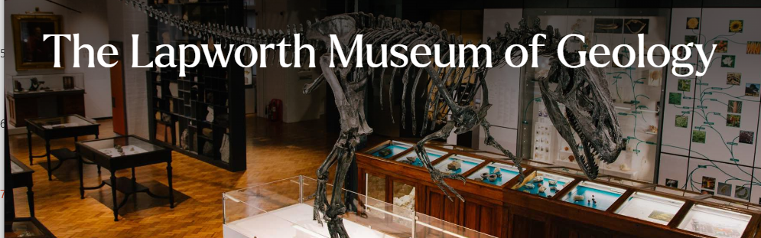


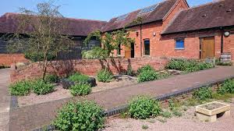

Curriculum: Trips and Visits
Our trips and visits are planned to specifically meet certain objectives and to support the
learning happening within the classroom. This helps to deepen the children’s understanding and allows them to have hands on experiences.
Where possible, a trip or visit is planned once a term in the hope that all children will have the opportunity to learn through a hands on approach.
Where possible, we will aim to reduce the costs of transport by inviting visitors and external workshops into school.

Slide 8
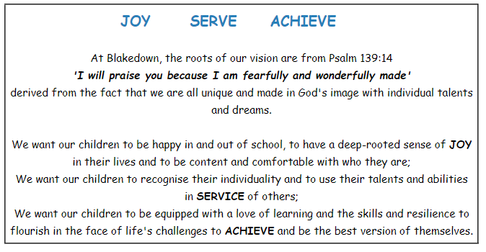
Our Christian Ethos

Slide 9





Christian Values
Trust
Respect
Peace
Forgiveness
Perseverance

Slide 10

Emotional Health and Wellbeing at Blakedown
We aim to promote positive mental health for every member of our staff and pupil body. We pursue this aim using universal (whole school approaches), targeted and specialised approaches supported by the emotional health and wellbeing pathway.
In addition to promoting positive mental health and wellbeing, we aim to recognise and respond to need as it arises. By developing and implementing practical, relevant and effective mental health and wellbeing policies and procedures we can promote a safe and stable environment for pupils affected both directly, and indirectly by mental health and wellbeing issues.
Children will experience clear well-being strategies during our PSHE sessions, Worship and our weekly well-being Wednesday class time.
*Further information can be found on our website or Mrs Marshall and Mrs Nash, our Mental Health First Aiders, can be contacted via the office.

Slide 11
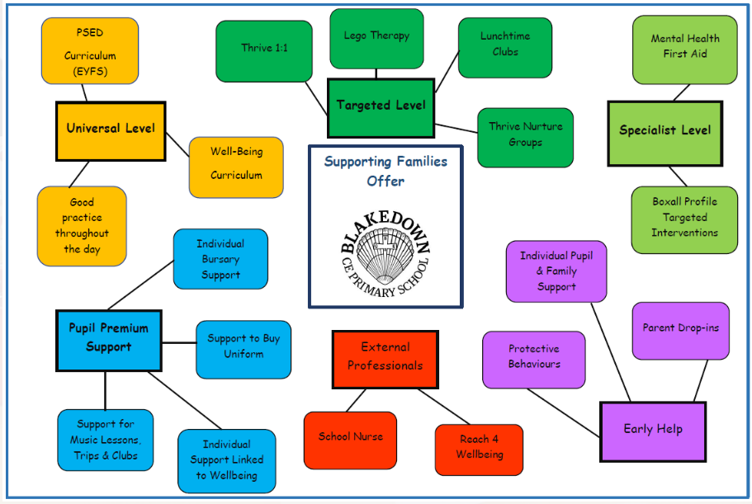
Supporting Families Offer – prev. Early Help

Slide 12

Behaviour/Recognition Board Expectations
Children are expected to abide by our school rules and values and behave in a way that helps them to learn, be safe and be respectful.
The recognition board allows us to praise positive behaviour and encourages them to achieve in all aspects of school.
If children do not make a good choice, they will be given a verbal warning which advises them about the inappropriate choice, the affect and possible consequence.
If children continue not to make a good choice, an appropriate consequence will be issued and further discussion about how to make better choices in the future will take place.
Key stage leads and parents may need to be contacted.
If a child has been recognised often throughout the week, they may be recognised within our Friday recognition assembly.

Slide 13

Behaviour/Recognition Board Expectations
In KS2, a consequence for a child may be to miss a part of their break time or lunch time.
If this behaviour persists following warnings and reminders, parents will be contacted and involved in conversations with both the teacher and child.
If this still continues to be an issue then parents will be invited in to discuss a formal action plan to support an improvement in their child’s behaviour. Further consequences such as earning a right to take part in events may also be issued.
We expect that children abide by our expectations, as a school, in respect of both their teaching staff and their peers.
We would thank all parents for supporting us with this both in and out of school.

Slide 14
Where to find information/points of contact
We are usually available before and after school either welcoming children on entry to school or dismissing at the end of the day.
Messages can be left with the children’s homework books or reading records.
We are contactable via the office to arrange meetings or call backs
Information can be found on the school website, class pages and newsletters for further clarification – please read these!

Slide 15

How you can help?
Ensure lunchtime hot food orders are ordered on time and through the correct channels
Time keeping and limit absences
Organisation – drinks, belongings, PE; All named.
Naming uniform and water bottles
Support with home tasks, reading, spelling and X tables
Ensure you keep us informed as best as you can with daily occurances that may affect your child’s well-being and ability to learn.

Slide 16

Building Relationships
We work hard to build strong relationships between staff, parents and children in order to provide the best learning environment for everyone at Blakedown CE Primary School.
We appreciate communication which facilitates moving forward to achieve the best for your child.
We look forward to working in partnership with you over this academic year!

Slide 17

Look out for…
Pioneer meeting for Year 4
Possible reading at home workshops
Possible maths workshops
Year 4 Multiplication workshop

Slide 18

Any Questions?
If you have any questions please feel free to stop and discuss these with us now.
Thank you for joining us today.

