Slide 1
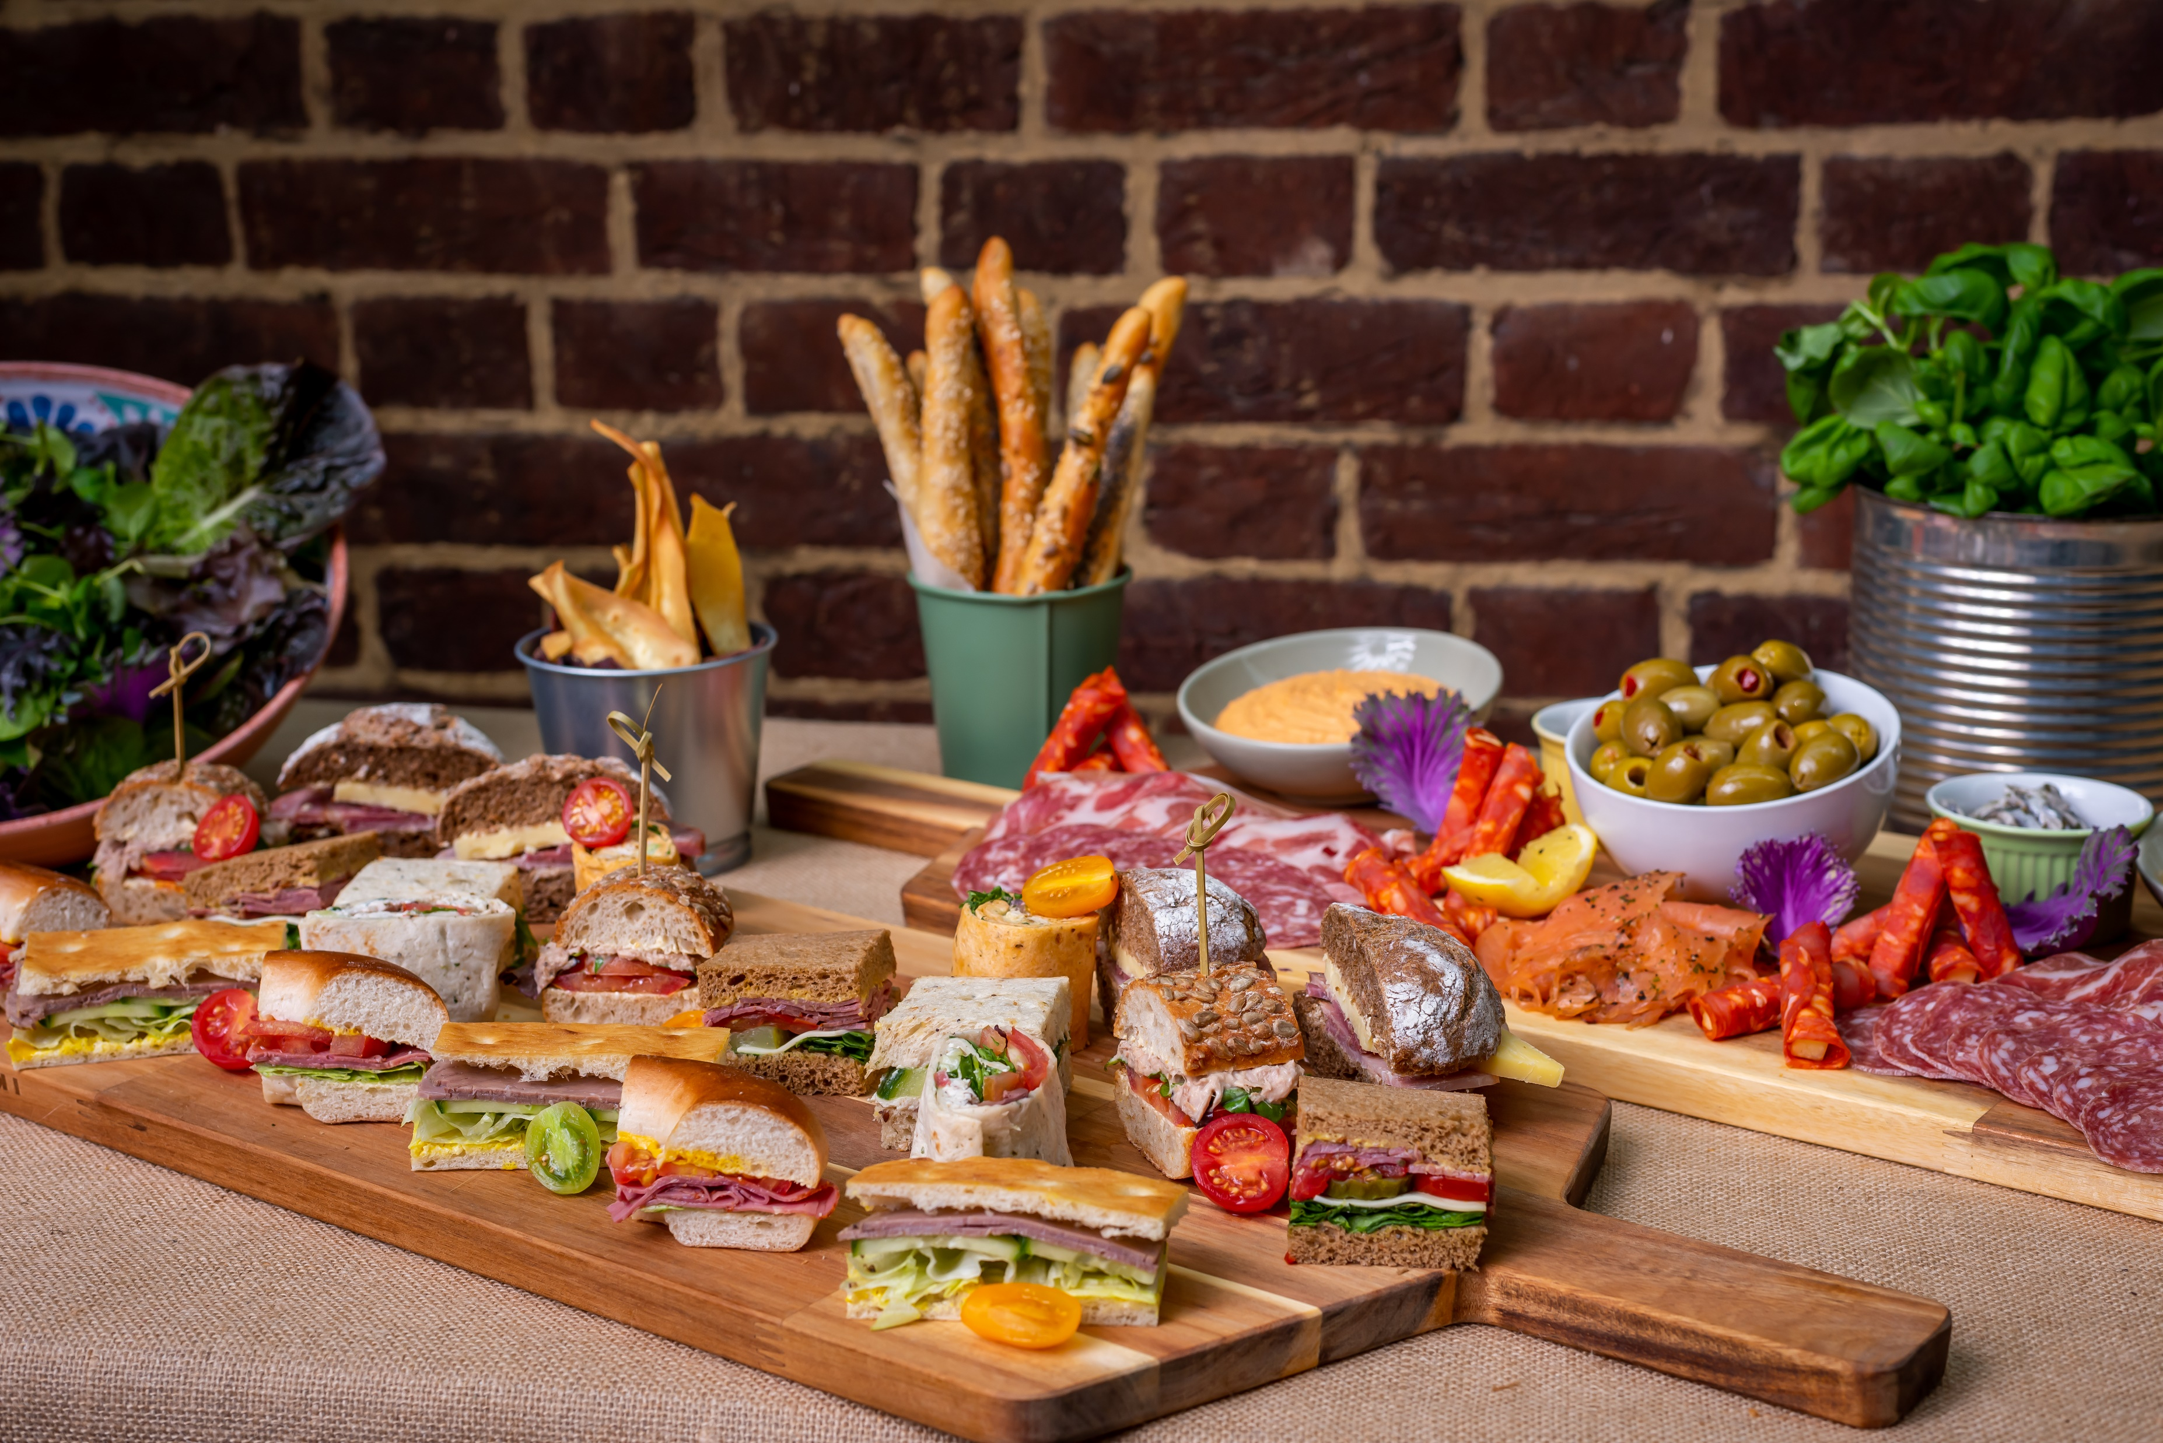


Parent Ordering

Slide 2

Impact Food App
The ordering platform is supported by a company called Kanpla, one of our technology partners.
It is user friendly, easy to use and has been designed to be as simple as ordering something from Amazon.

Slide 3
Impact Food Group
How does it work?
How links work
Ease of accepting
Navigating the Impact Food Group app
Adding a balance
Placing orders
Ordering with allergies

Slide 4
How links work
/
You will receive a link from Kanpla via email.
One child = One Link
Links are generated from information provided by the school MIS (Management Information System) data
Currently, only one link per parent
Once the link is accepted it cannot be used again
Links will automatically be sent to the email address you have given the school office
Siblings can be linked together when the parent uses the same email address on each link

Slide 5
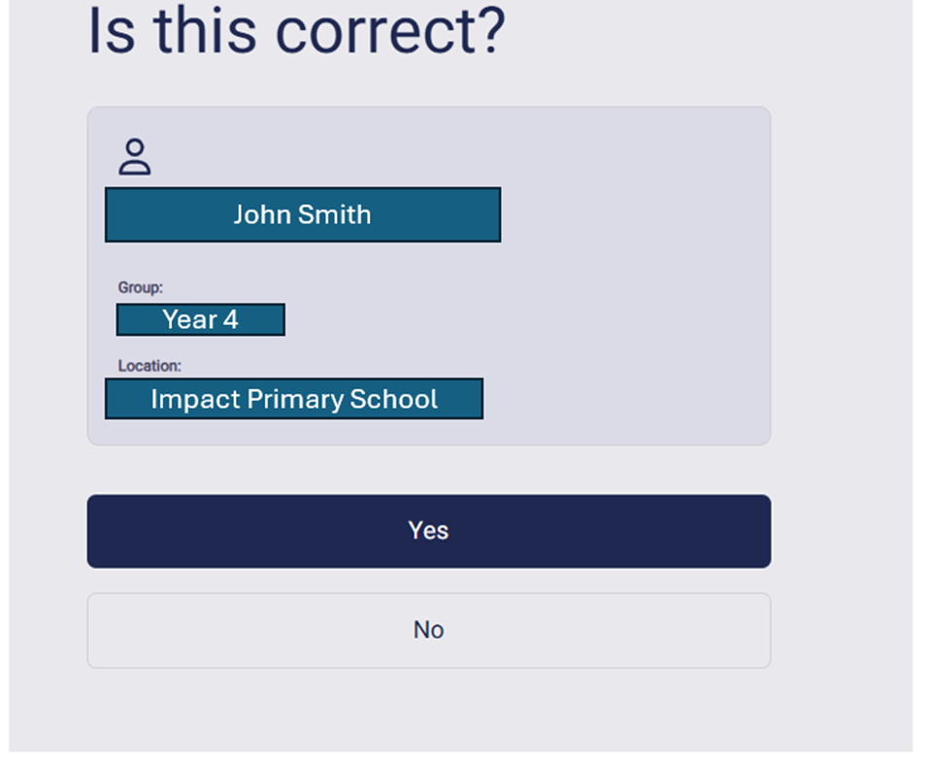
Accepting the Link sent to you:
Each child’s link will need to be manually accepted
Check the Student name, Class, Year Group and School.
If correct, press Yes

Slide 6
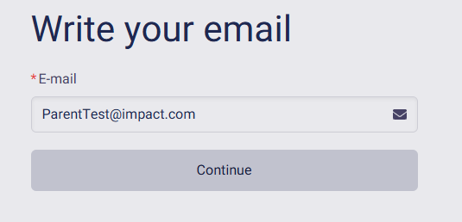
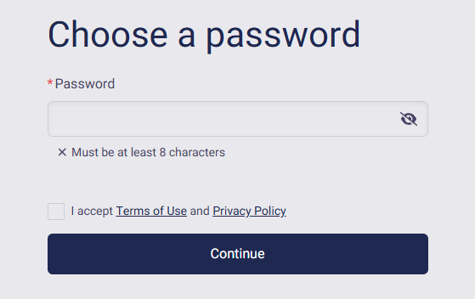
Creating your Username and Password
ParentTest@impact.com (Your email address)
Password: Somethingyouchoose
(make it something you will remember but that you have not used somewhere else)

Slide 7
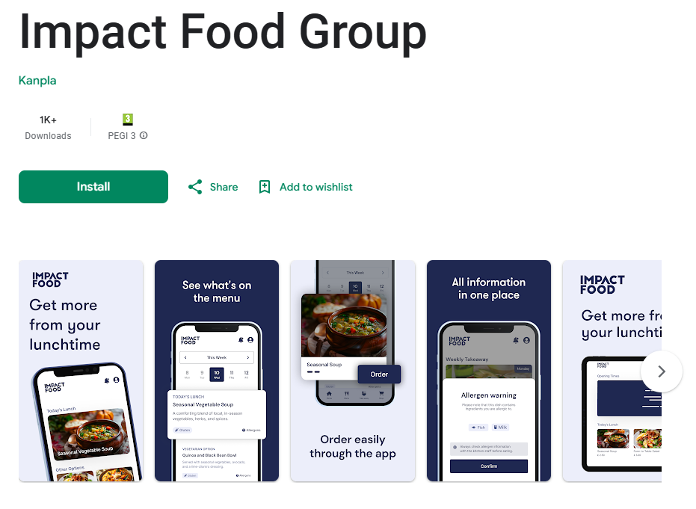
The App
Accept
Accept the link
Create
Create your account
Download
Download the App

Slide 8
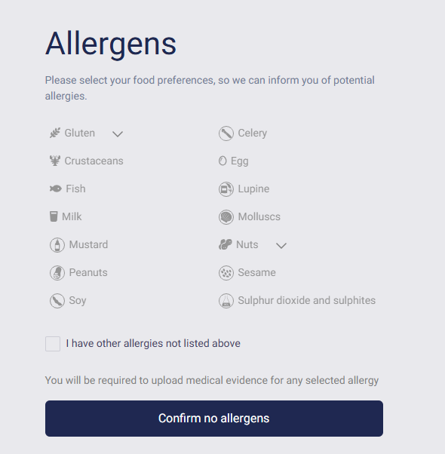
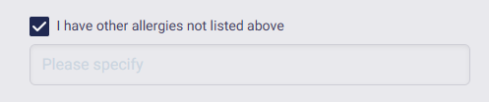
Does your child have an allergy?
Allergens must be declared before moving on to the meal ordering page
If the student does not have allergies, press ‘Confirm no allergens’
If allergen is not listed, please type in the below box

Slide 9
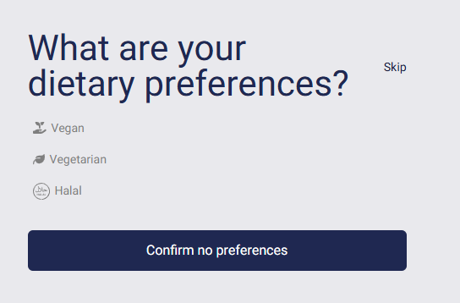
Filtering for Preferences
It is possible to filter meals to only show Vegan, Vegetarian or Halal (if offered), select the preference and continue.
Can be skipped or confirmed as no preference

Slide 10
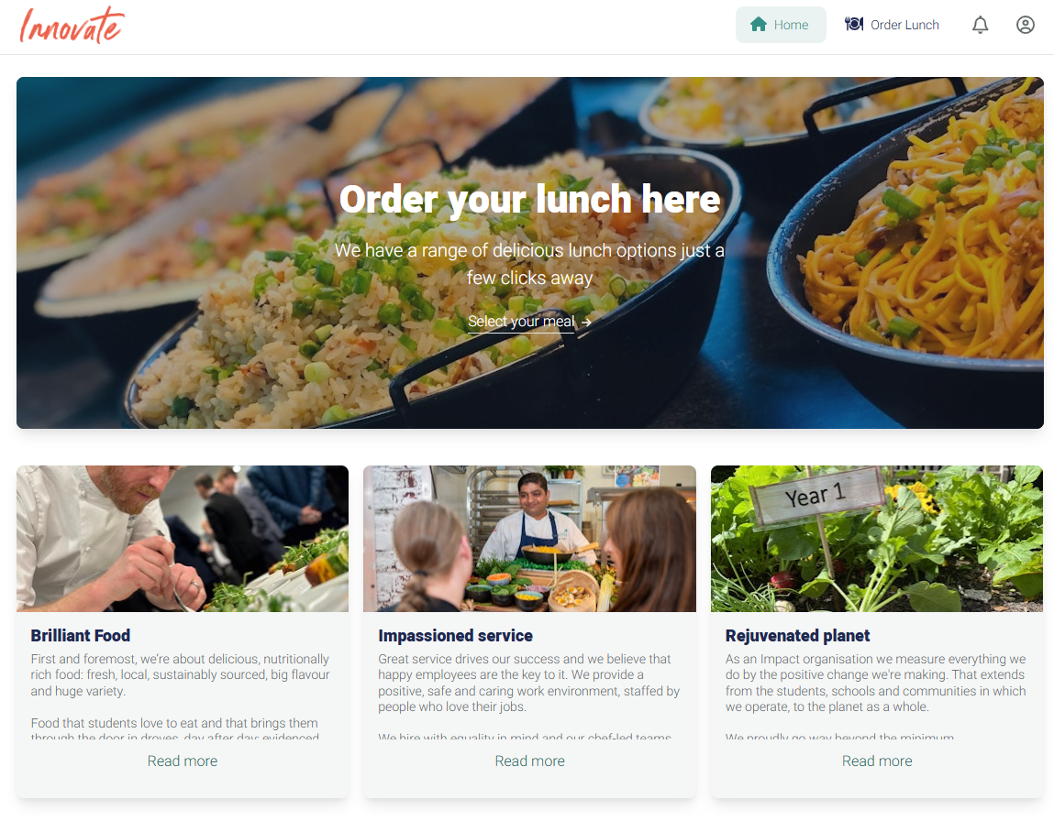
Welcome to the Homepage (Webpage)
Account Details
Order meals

Slide 11
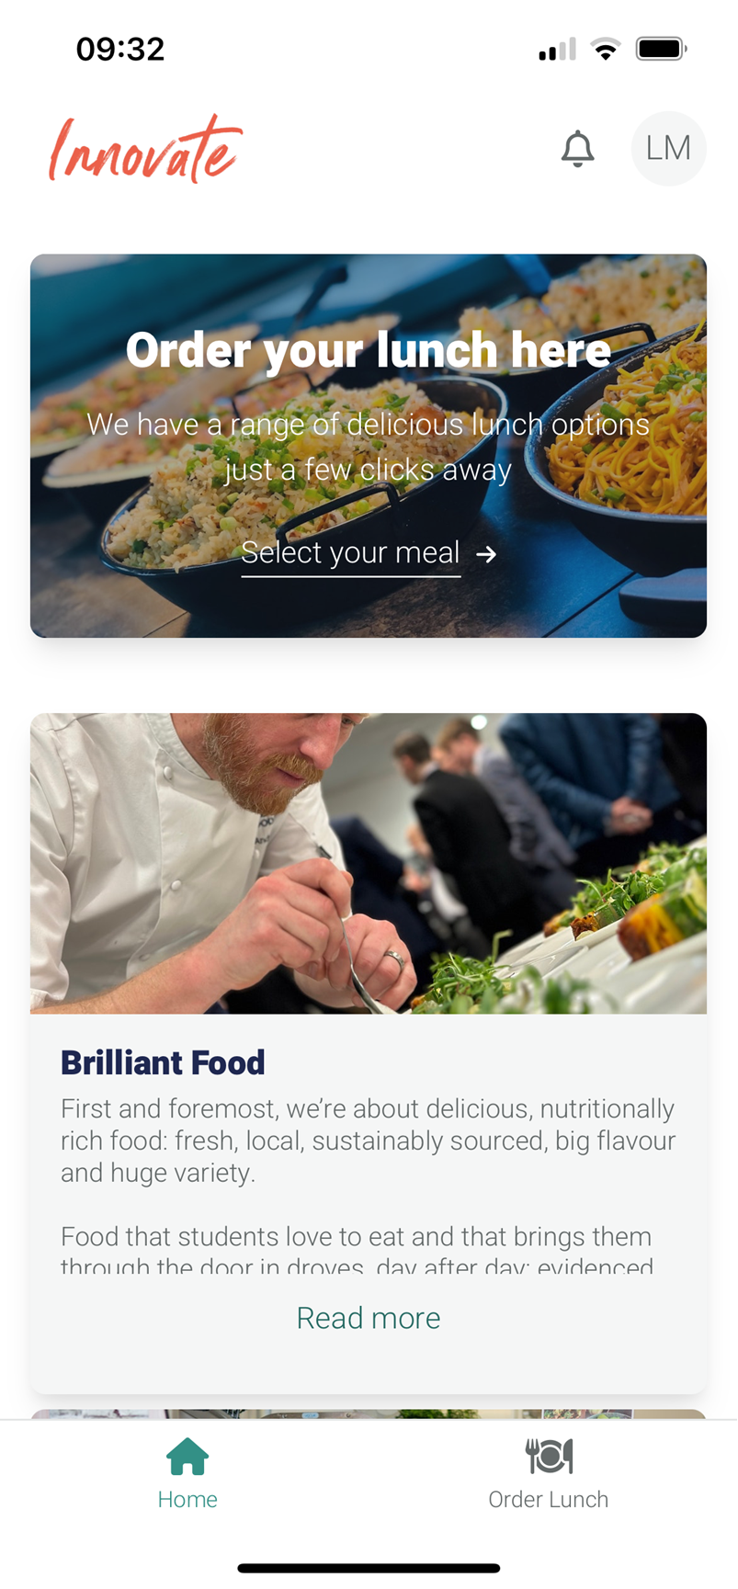
Welcome to the Homepage (Mobile app)
Account Details
Order meals

Slide 12
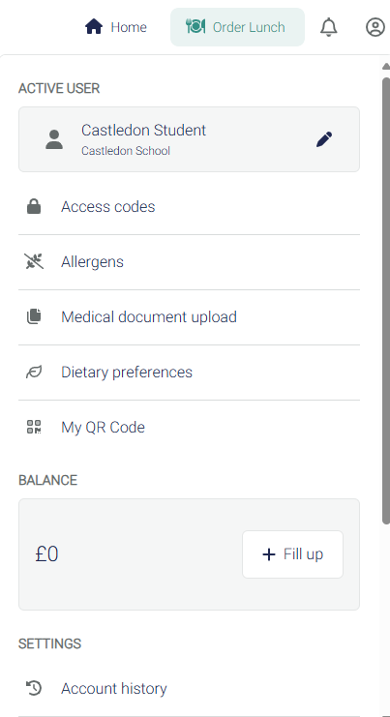
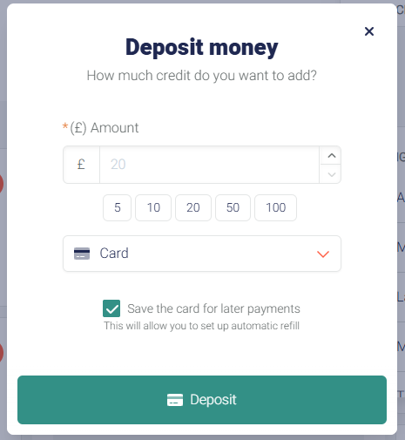
Adding Balance
A balance, if applicable, must be on the account before selecting a meal
If multiple paid siblings, the balance will be split between them. Account will only show one total balance

Slide 13
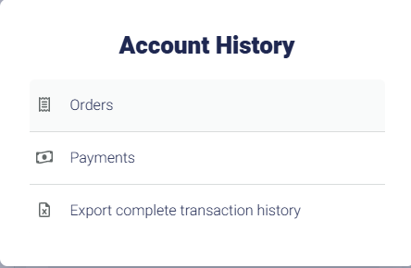
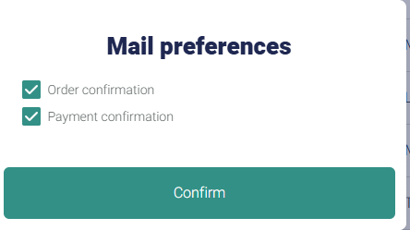
Notification Preferences
Parents can view all placed orders under the ‘Orders’ section
Transaction history will provide all account history
Parents will be notified of any meal cancellations or changes

Slide 14
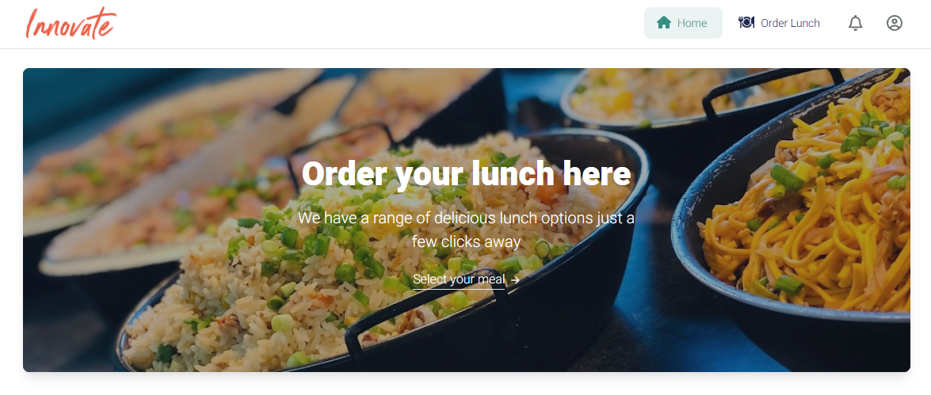
Ordering a meal

Slide 15
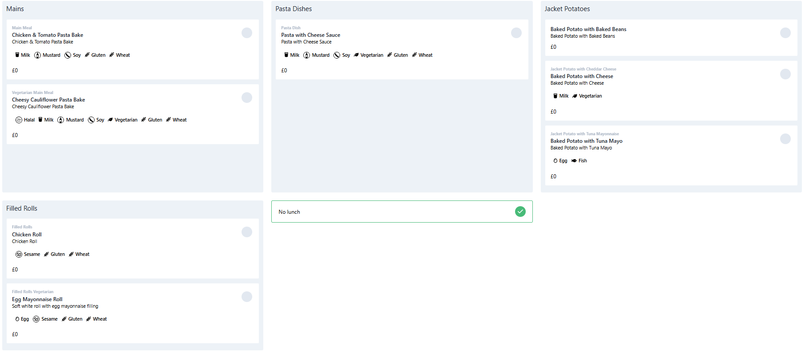
Ordering a meal (Webpage)
Parents will have the option to select from a variety of meals offered daily
Menus alternate based on a three-week cycle

Slide 16
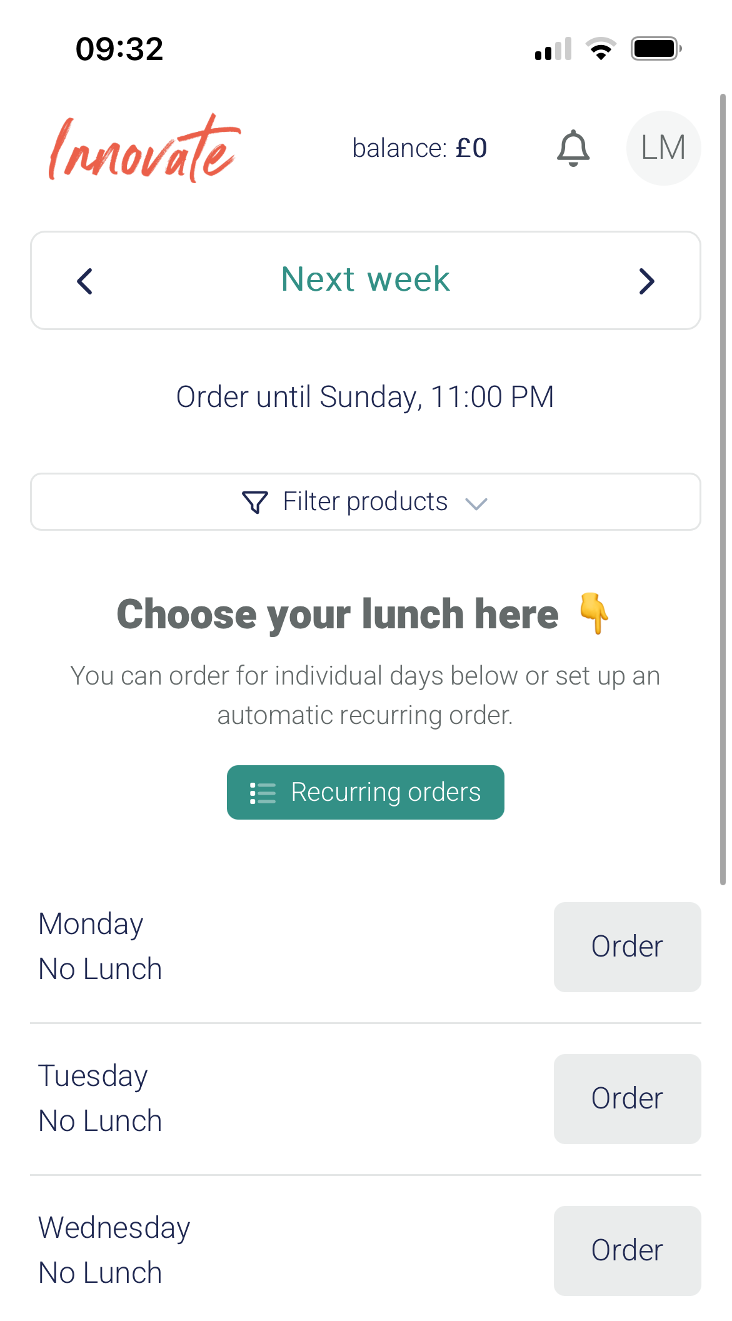
Ordering a meal (Mobile App)
Weeks can be changed by pressing the left and right arrows. Dates will be visible at the top
Weekly meal ordering deadline
Daily orders can be selected by pressing the ‘Order’ buttons

Slide 17
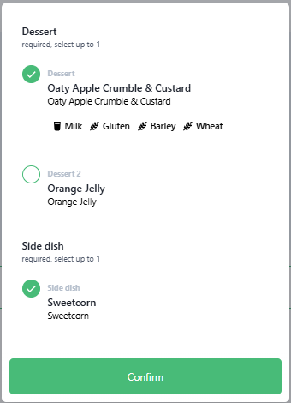
Selecting Desserts
After selecting a main meal, a dessert option box will appear asking the user to select one of two dessert options
Fruit is always available at the meal collection counter

Slide 18
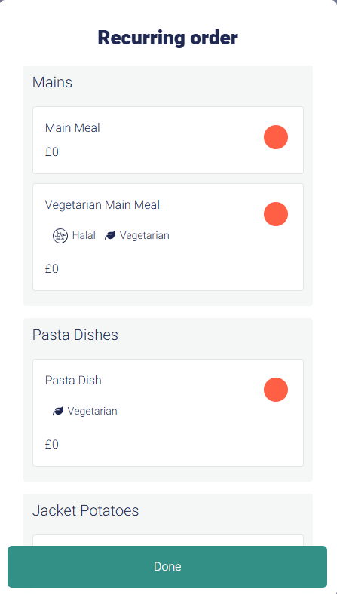
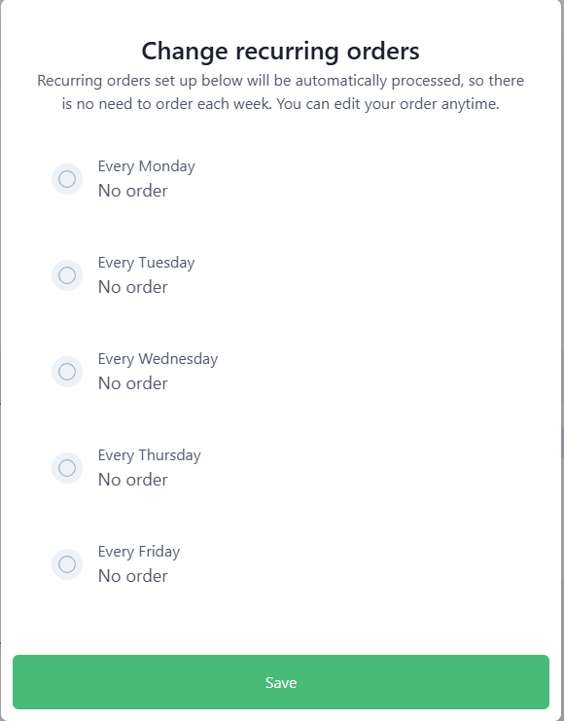
Recurring Orders
For convenience, there is an option to select recurring orders weekly.
Please keep in mind the menu options change weekly based on a three-week cycle

Slide 19
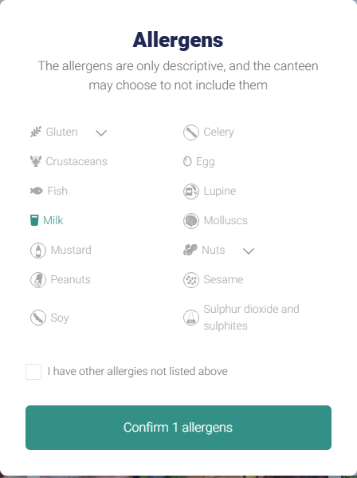
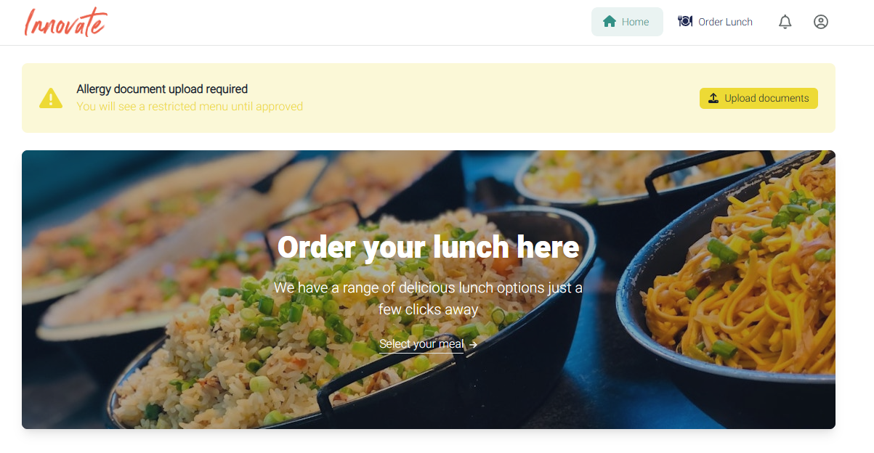
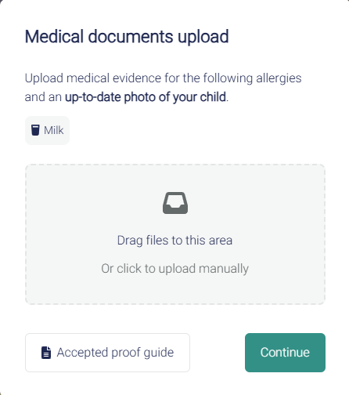
Ordering With Allergies
Documents are required to ensure appropriate meals are provided. Reviewed by the Safety Team
Milk allergy declared

Slide 20
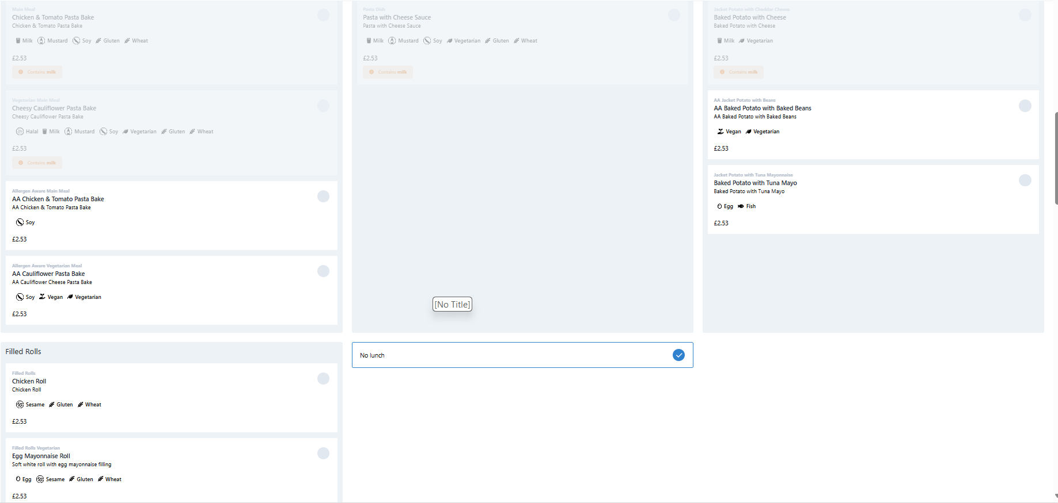
Placing an Allergen Appropriate Order
As a ‘Milk’ allergy was declared, all menu options containing ‘Milk’ are not available to this student. Alternative Allergen Aware meals are available to select

Slide 21
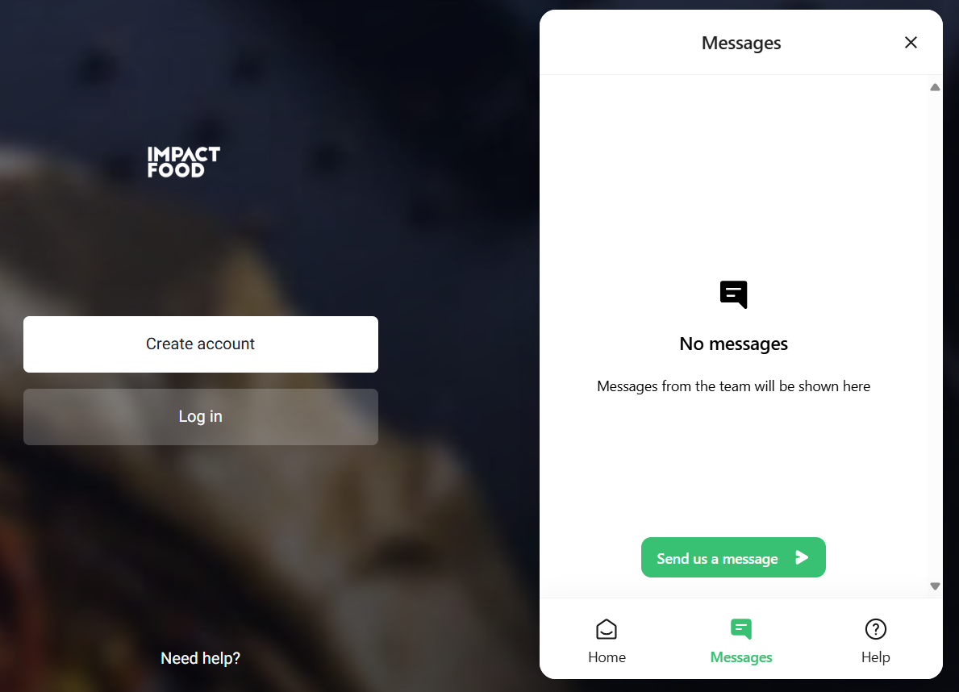
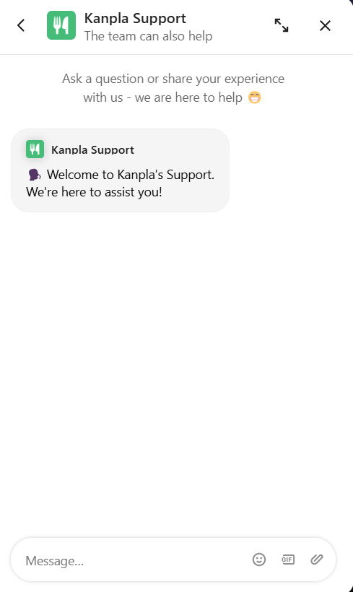
Need some help?
Contact IFG
Primary Support Team
primary@impactfood.co.uk
Telephone: 0204 542 7211
Monday – Friday, 8.30am – 5.30pm
OR
Contact Kanpla
Support chat function available on mobile and website– technical issues, account assistance, general app enquiries

