Slide 1
KS2 Maths parent workshop
Autumn Term 2024

Slide 2
Purpose
To give updates on maths teaching to parents
Highlight any misconceptions
Give examples of methods that can be used to help children with homework

Slide 3
GLOW Maths
What is it?
Does it work?

Slide 4
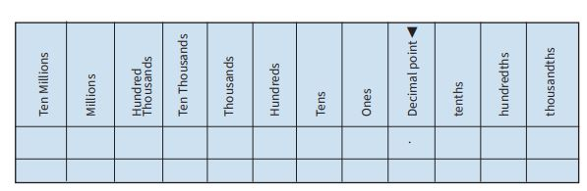
Place Value
Increase the value of the digit(s) NOT move the decimal point or add a ‘0’
Y3 - compare and order numbers up to 1000
Y4 - recognise the place value of each digit in a four-digit number (thousands, hundreds, tens, and ones)
Y5 - read, write, order and compare numbers to at least 1 000 000 and determine the value of each digit
Y6 - read, write, order and compare numbers up to 10 000 000 and determine the value of each digit

Slide 5
Four operations
Addition
Add
Plus
More than
Sum
Increase
Subtraction
Minus
Take away
Less than
Decrease
Difference
Multiplication
Times
Product
Lots of
Division
Groups of
Quotient

Slide 6
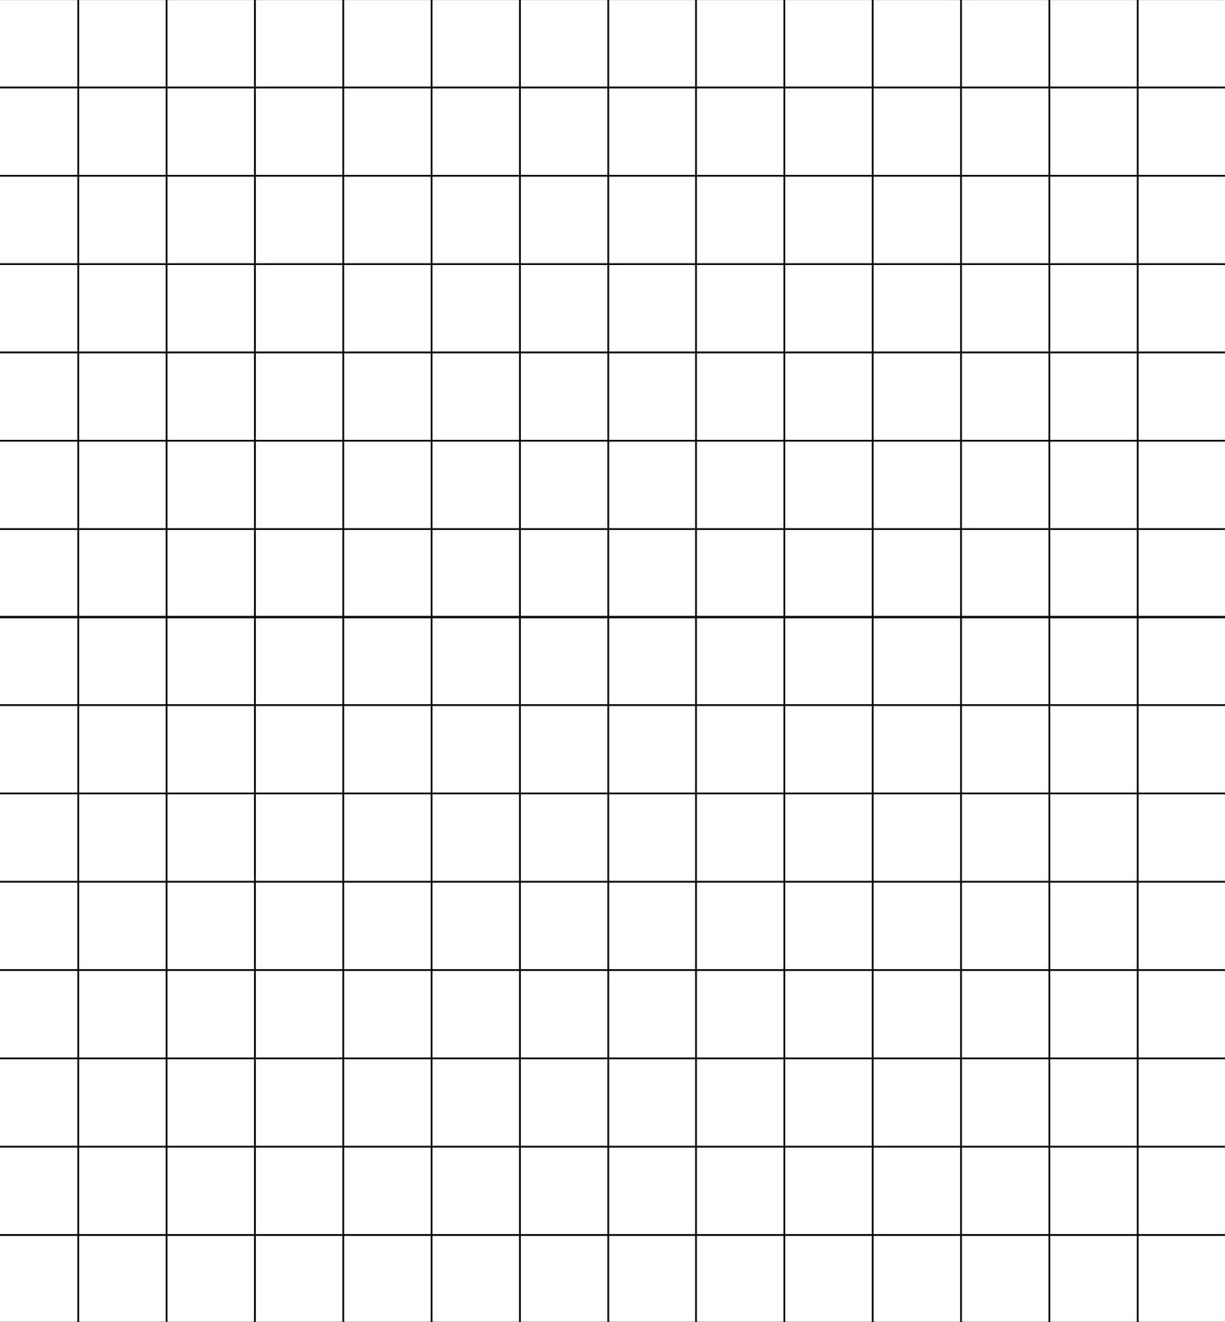
Four operations
Exchange NOT carry
4562 + 1363
6578 – 2295
5623 x 7
2792 ÷ 8
Y3 - add and subtract numbers with up to three digits
Y4 - add and subtract numbers with up to 4 digits using the formal written methods
Y5 - add and subtract whole numbers with more than 4 digits, including using formal written methods
Y6 - multiply multi-digit numbers up to 4 digits by a two-digit whole number using the formal written method of long multiplication

Slide 7
Fractions
2
Numerator
5
Denominator

Slide 8
Equivalent fractions
1
11
4
15
3
9

Slide 9
Adding and subtracting fractions
2
3
+
6
6

Slide 10
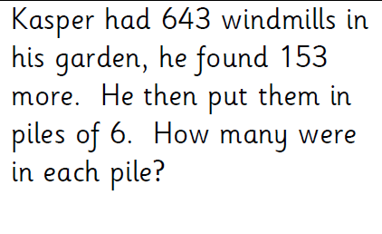
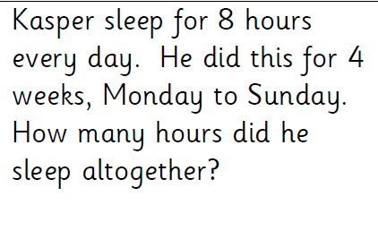
Multi-step problems

Slide 11
Multi-step problems
Sandwich = £2.35
Drink = £1.30
Crisps = 80p
James buys 2 sandwiches, a drink and 2 bags of crisps. If he pays with a £10 note, how much change will he get back?

Slide 12
Times Tables
What we use to help
How we TEACH multiplication/division facts

